Slide 1
Minimum Acceptance Criteria for Conditioning Subsurface Modeling using Generative AI
Direct Consortium 5th annual meeting
August 30th, 2024
Ahmed Merzoug
Graduate Research Assistant, The University of Texas at Austin
Lei Liu
Professor, The University of Texas at Austin
Michael J. Pyrcz
Professor, The University of Texas at Austin

Slide 2
Outline
Executive Summary
Introduction
Methodology
Results
Conclusions
Well pad 1

Slide 3
Executive Summary
Your executive summary here
Generative artificial intelligence is proposed as a solution to the limitation of the traditional geostatistics approach in balancing conditioning to data location and conditioning to formative geological processes.
We propose a minimum acceptance protocol for generative AI (genAI) applications in subsurface modeling. This protocol augments established geostatistical model checks for robust quantitative checks of the genAI-based realizations.
We apply the proposed workflow on variational autoencoder (VAE), generative adversarial networks (GAN) and diffusion probabilistic models (DDPM). The results shows that the models have inherent limitations to their applications in subsurface modeling which can impact subsurface development decision making.
We recommend that this protocol is applied to genAI-based subsurface modeling techniques before putting a leap of faith in their realizations.
Well pad 1

Slide 4
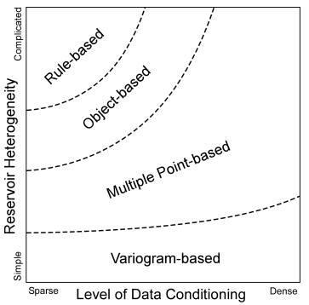
Introduction
Generative AI (genAI) has resulted in new reservoir modeling capabilities with the promise of geological realism of rule-based geostatistical and physics-based models and the unlimited data conditioning of pixel-based geostatistical models
Generative AI includes several algorithms. The common practices are based on visual inspection or limited quantitative checks.
We propose minimum acceptance checks for subsurface genAI models. These checks are applied to three different genAI algorithms for comparison and realizations checks.
Well pad 1
Figure 1 Schematic representation of the optimal reservoir modeling approach in relation to the extent of data conditioning and the degree of reservoir heterogeneity (Pyrcz et al., 2006).

Slide 5
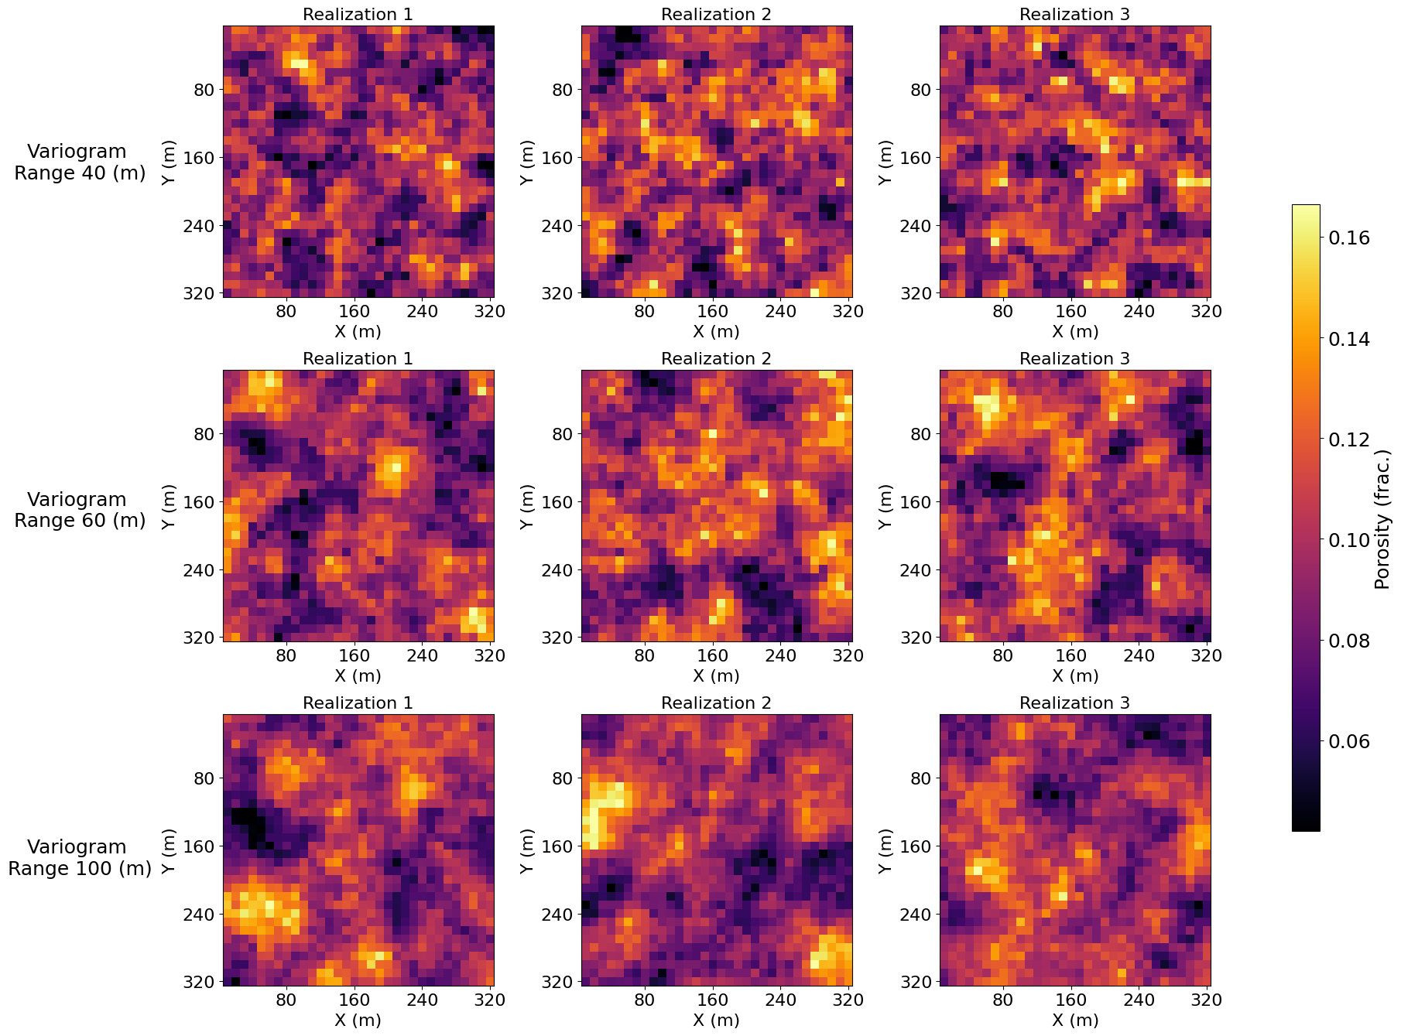
Methodology
Demonstration of the New Subsurface genAI Model Checks
Generate TIs (SGSIM)
Well pad 1
Variogram Range 40 (m)
Train genAI models
Generate Realizations
Variogram Range 60 (m)
Apply minimum acceptance criteria checks
Results
Variogram Range 100 (m)
Figure 2. SGSIM Realizations

Slide 6
Methodology
Models training
Conditioning
Uncond. VAE
Cond. VAE
Conditioning the Models to Local Well Samples
Unconditional (Uncond.): models and simulation trained on unconditioned training images
Preconditional (Precond.): models and simulation trained on conditioned training images
Conditional (Cond.): conditioned models trained on unconditioned training images then conditioned by optimizing the latent space.
Uncond. SGSIM
Uncond. GAN
Cond. GAN
Uncond. DDPM
Precond. VAE
Precond. SGSIM
Precond. GAN
Precond. DDPM

Slide 7
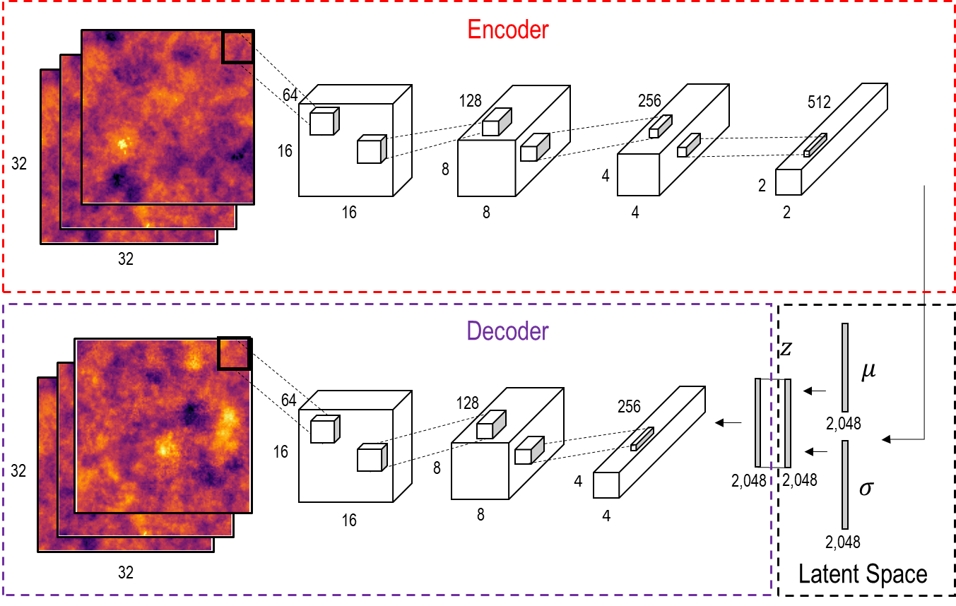
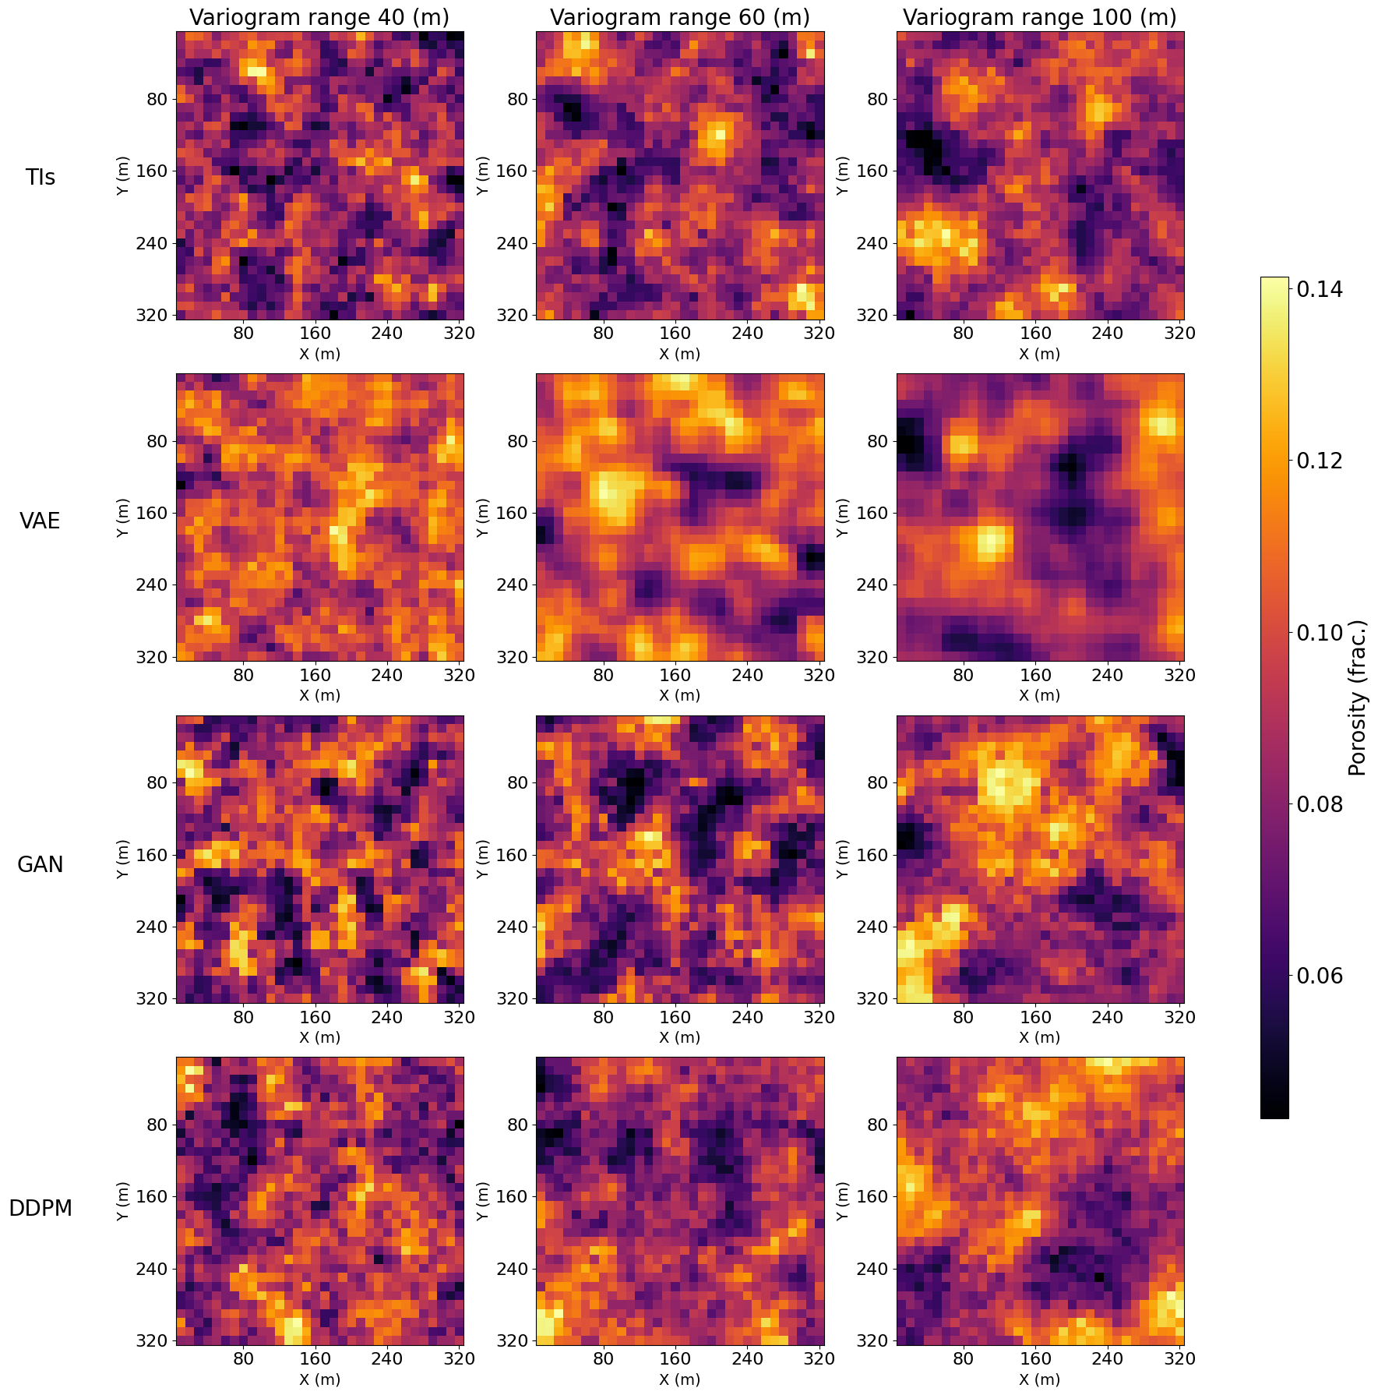
Methodology
GenAI models: Variational Autoencoder (VAE)
Encoder maps the TI into a lower-dimensional representation
Decoder reconstructs the input image from the latent space representation
Figure 3. VAE Architecture (Merzoug et al., 2024a)

Slide 8
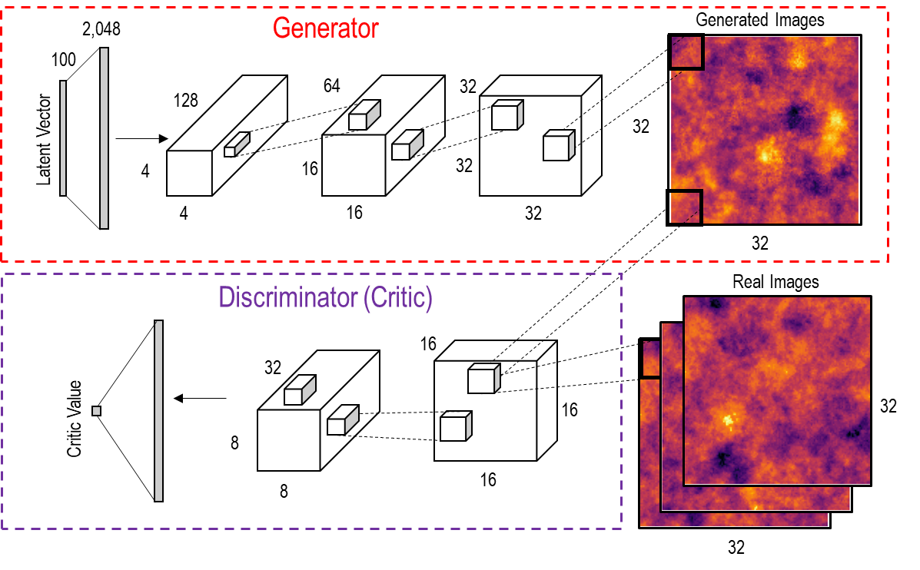
Methodology
GenAI models: Generative Adversarial Networks (GANs)
Generator generates images by mapping the latent vector to the data distribution
Discriminator discriminates real images and fake images generated by the generator.
Figure 4. GAN Architecture (Merzoug et al., 2024a)

Slide 9
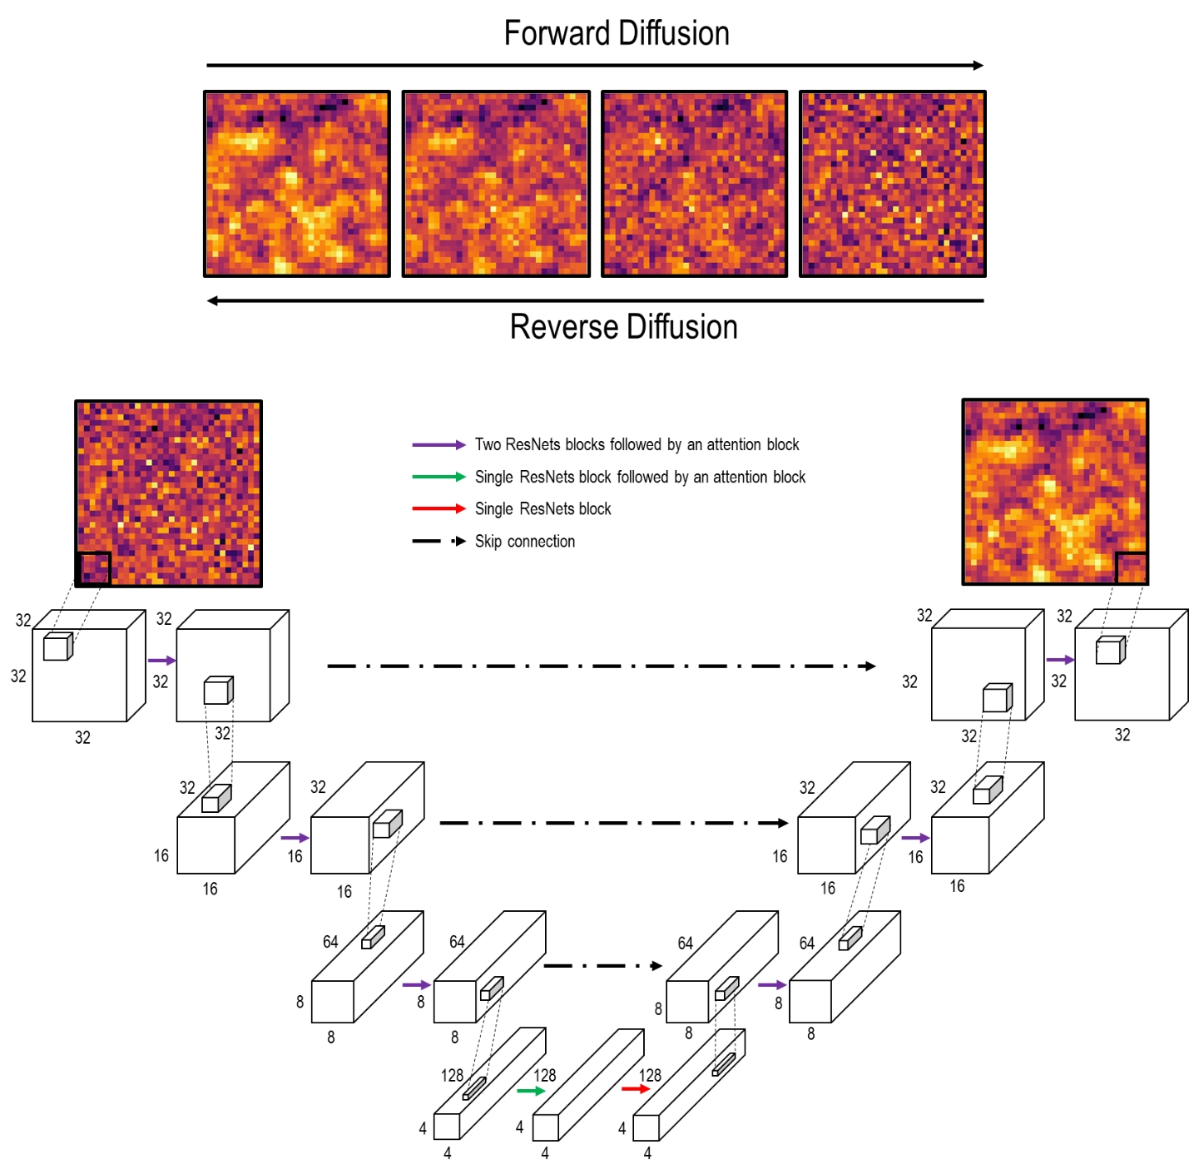
Methodology
GenAI models: Diffusion Probabilistic Models (DDPM)
Forward diffusion process gradually adds noise to the data in several steps, transforming the data distribution into a Gaussian noise distribution
Reverse diffusion process (denoising) removes the noise iteratively from the noisy data samples and transforms them back to the samples from the original data distribution.
Figure 5. DDPM Architecture (Merzoug et al., 2024a)

Slide 10
Variogram range 40 (m)
Variogram range 60 (m)
Variogram range 100 (m)
Methodology
Subsurface GenAI Model Minimum Acceptance Criteria Checks
1
Global Univariate Distribution
Local Uncertainty
Global Uncertainty
Global Spatial Continuity
Local Data Exactitude
Dynamic Response
2
3
4
5
6
Figure 6. GenAI realizations

Slide 11
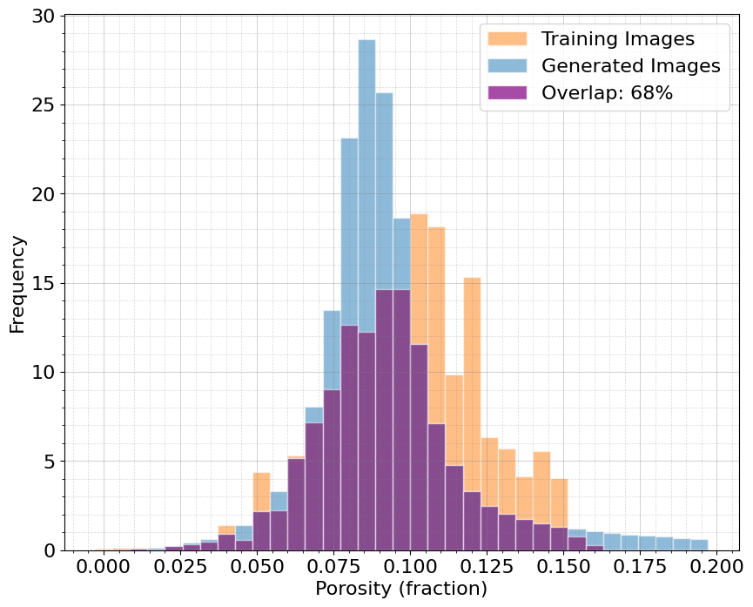
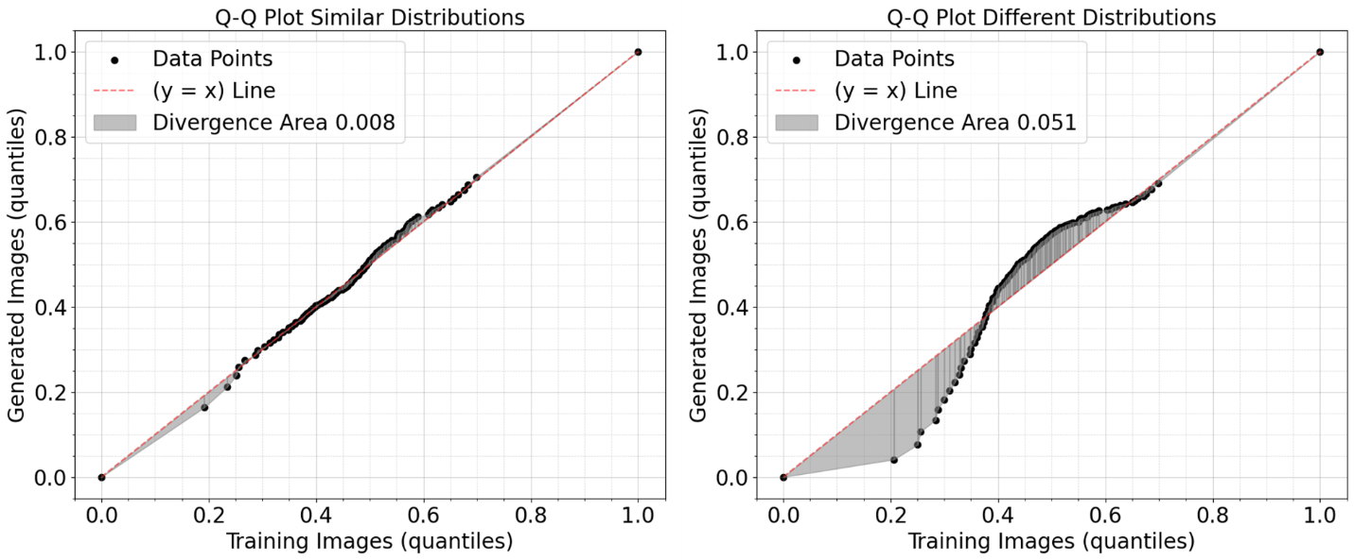
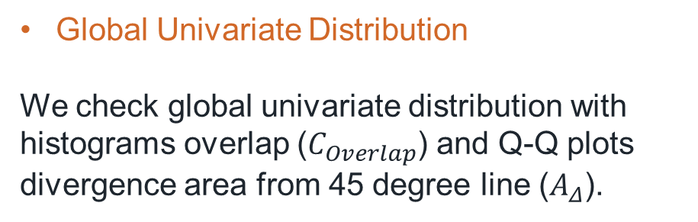
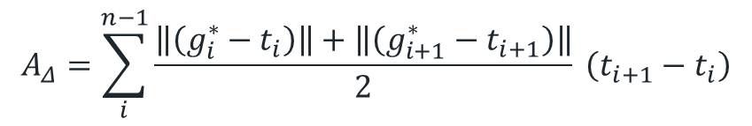
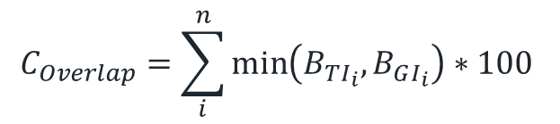
Methodology
Subsurface GenAI Model Minimum Acceptance Criteria Checks
1
Global Univariate Distribution
We check global univariate distribution with histograms overlap ($C_{Overlap}$) and Q-Q plots divergence area from 45 degree line ($A_{Δ}$).
Figure 7. Distribution overlap (Merzoug et al., 2024b)
$$C_{Overlap}=\sum_{i}^{n}{\min\left(B_{TI_{i}},B_{GI_{i}}\right)}∗100$$
$$A_{Δ}=\sum_{i}^{n−1}{\frac{\left\|\left(g_{i}^{∗}−t_{i}\right)\right\|+\left\|\left(g_{i+1}^{∗}−t_{i+1}\right)\right\|}{2}} \left(t_{i+1}−t_{i}\right)$$
Figure 8. Q-Q plot divergence area (Merzoug et al., 2024b)

Slide 12
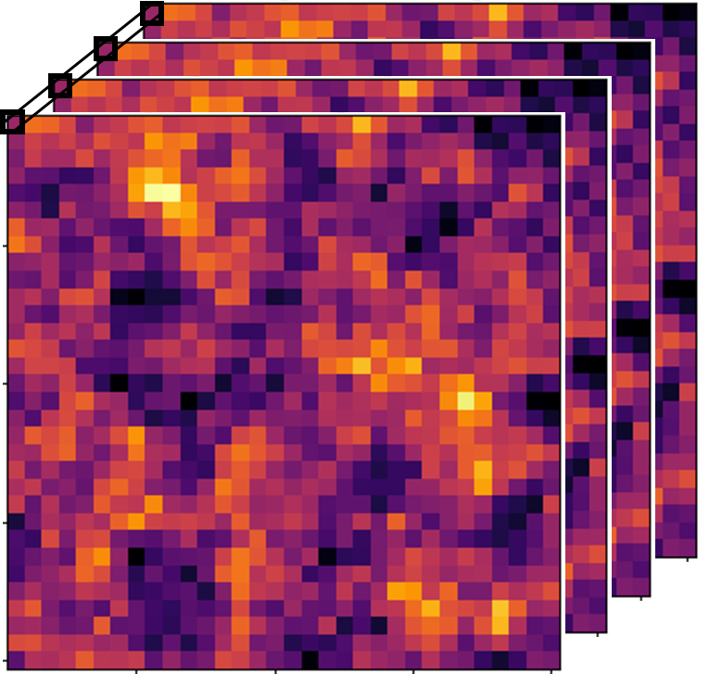
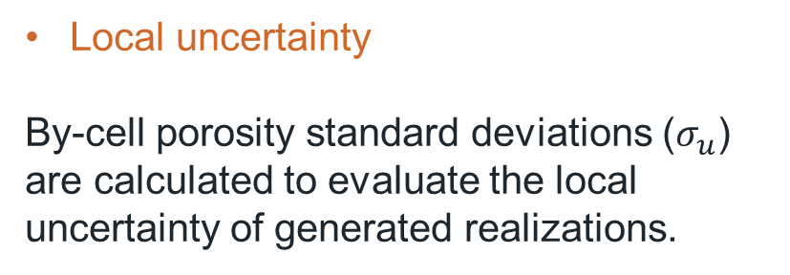
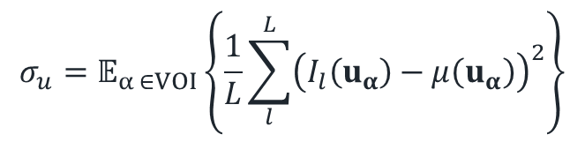
Methodology
Subsurface GenAI Model Minimum Acceptance Criteria Checks
Local uncertainty
By-cell porosity standard deviations ($σ_{u}$) are calculated to evaluate the local uncertainty of generated realizations.
2
$$σ_{u}=𝔼_{α ∈VOI}\left\{\frac{1}{L}\sum_{l}^{L}{{\left(I_{l}\left(u_{α}\right)−μ\left(u_{α}\right)\right)}^{2}}\right\}$$
Figure 9. By-cell standard deviation for porosity distribution

Slide 13
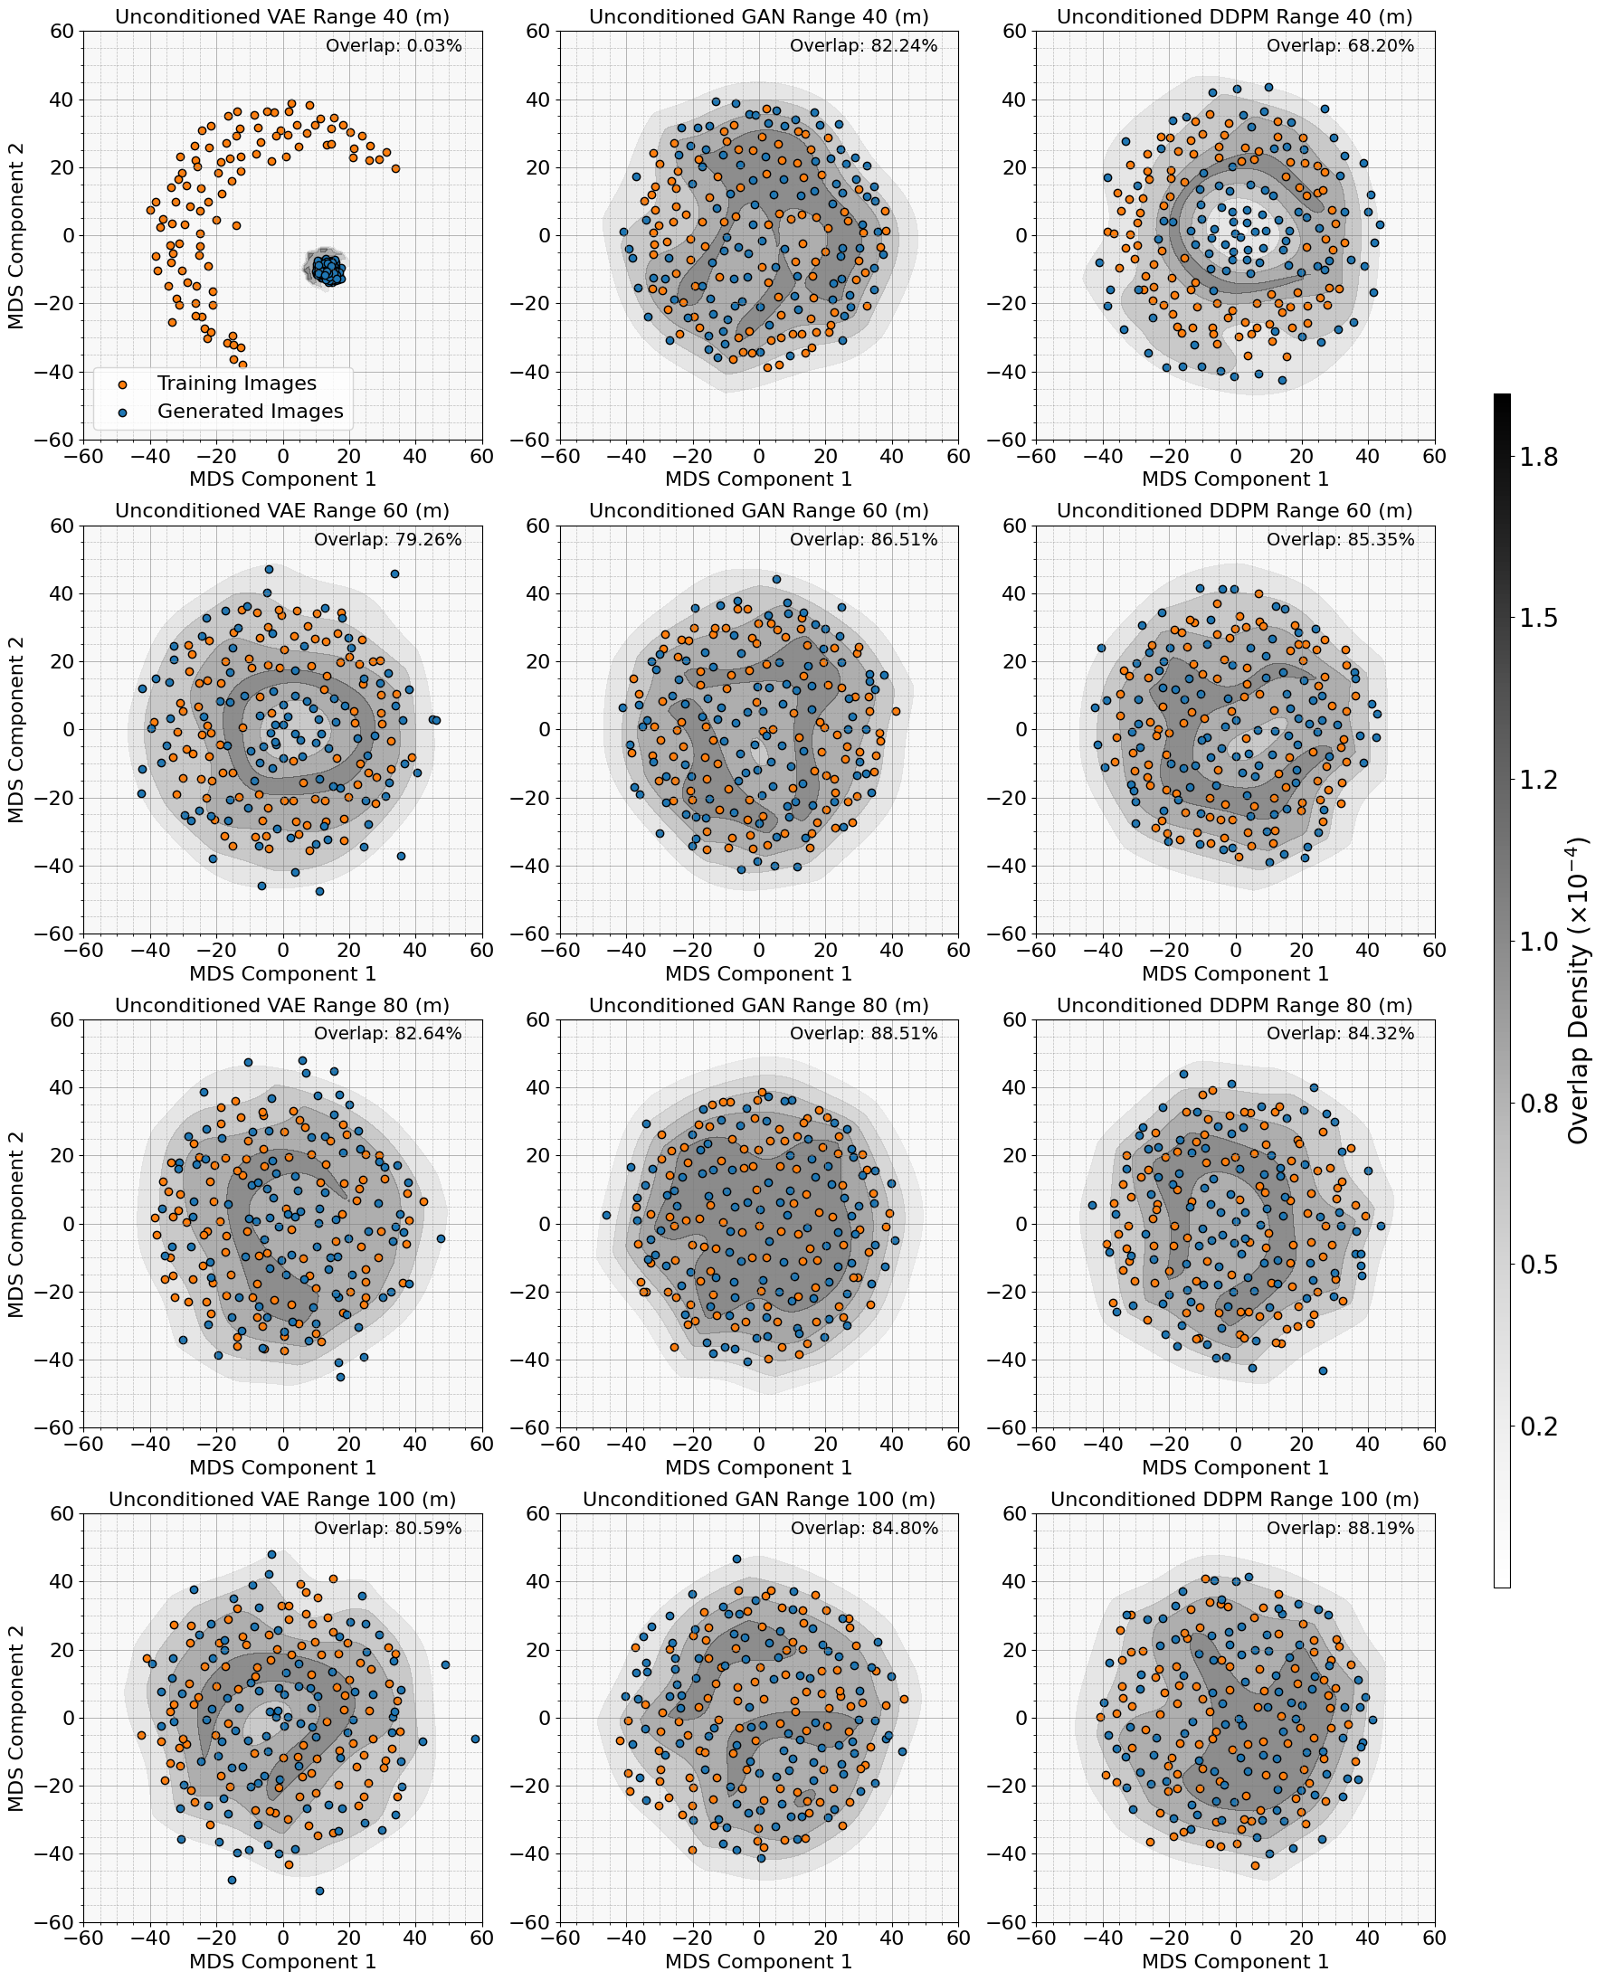
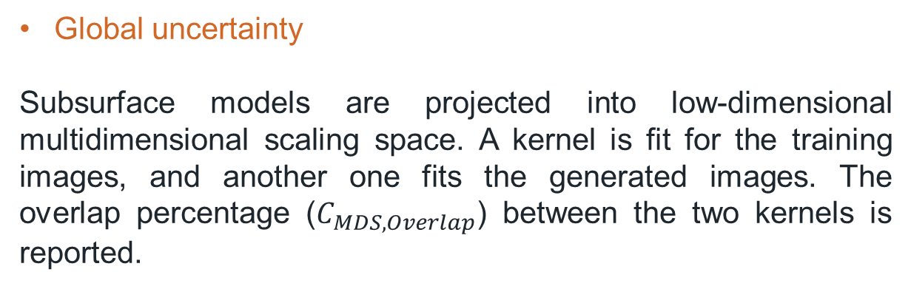
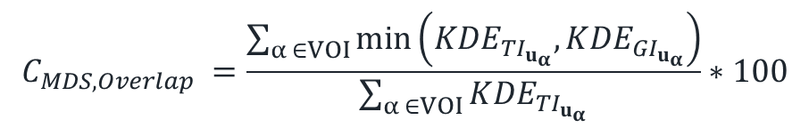
Methodology
Subsurface GenAI Model Minimum Acceptance Criteria Checks
Global uncertainty
Subsurface models are projected into low-dimensional multidimensional scaling space. A kernel is fit for the training images, and another one fits the generated images. The overlap percentage ($C_{MDS, Overlap}$) between the two kernels is reported.
3
$$C_{MDS, Overlap} =\frac{\sum_{α ∈VOI}{\min\left({KDE}_{TI_{u_{α}}}, {KDE}_{GI_{u_{α}}}\right)}}{\sum_{α ∈VOI}{{KDE}_{TI_{u_{α}}}}}∗100$$
Figure 10. Overlap in MDS space (Merzoug et al., 2024a)

Slide 14
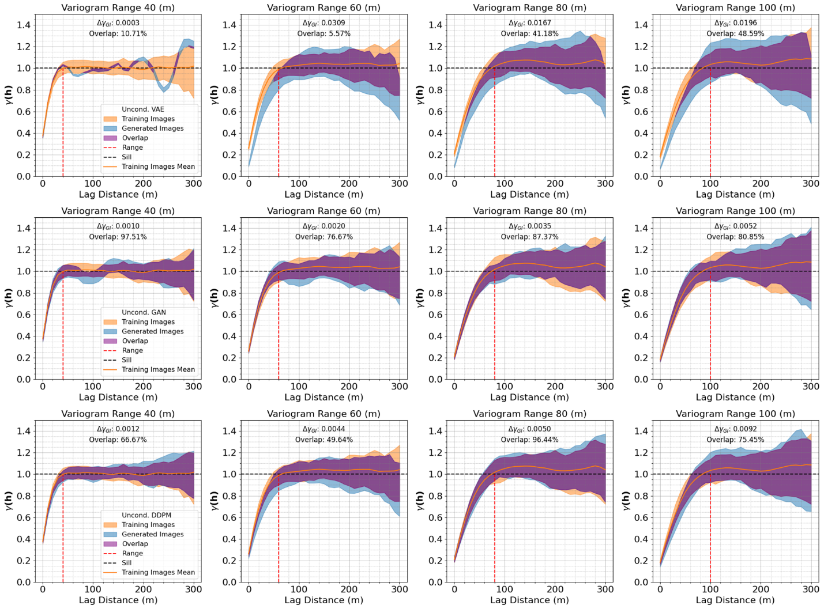
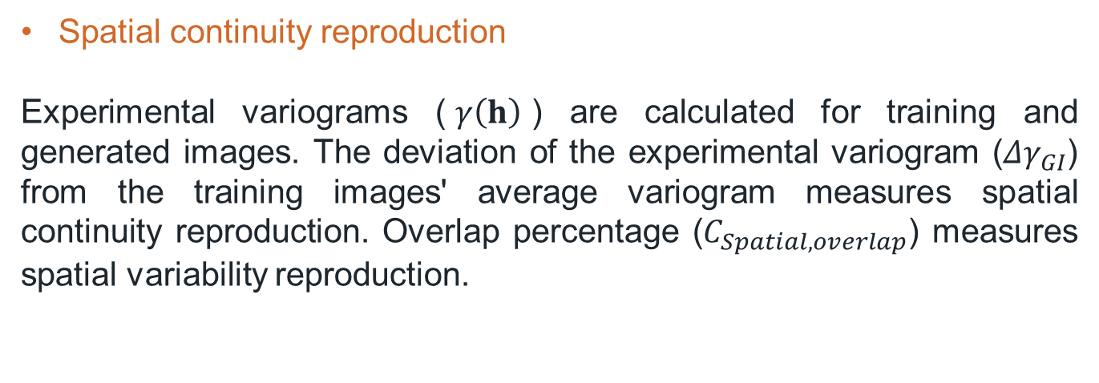
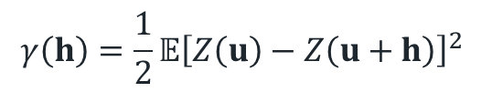
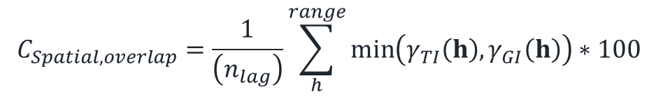
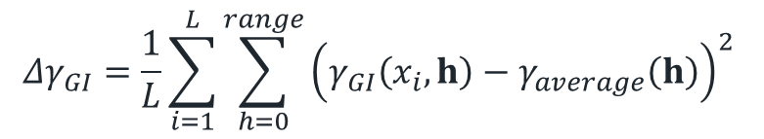
Methodology
Subsurface GenAI Model Minimum Acceptance Criteria Checks
Spatial continuity reproduction
Experimental variograms ($γ\left(h\right)$) are calculated for training and generated images. The deviation of the experimental variogram (${Δγ}_{GI}$) from the training images' average variogram measures spatial continuity reproduction. Overlap percentage ($C_{Spatial,overlap}$) measures spatial variability reproduction.
4
$$γ\left(h\right)=\frac{1}{2}𝔼{\left[Z\left(u\right)−Z\left(u+h\right)\right]}^{2}$$
$${Δγ}_{GI}=\frac{1}{L}\sum_{i=1}^{L}{\sum_{h=0}^{range}{{\left(γ_{GI}\left(x_{i},h\right)−γ_{average}\left(h\right)\right)}^{2} }}$$
$$C_{Spatial,overlap}=\frac{1}{\left(n_{lag}\right)}\sum_{h}^{range}{\min\left(γ_{TI}\left(h\right),γ_{GI}\left(h\right)\right)}∗100$$
Figure 11. Experimental variograms (Merzoug et al., 2024a)

Slide 15
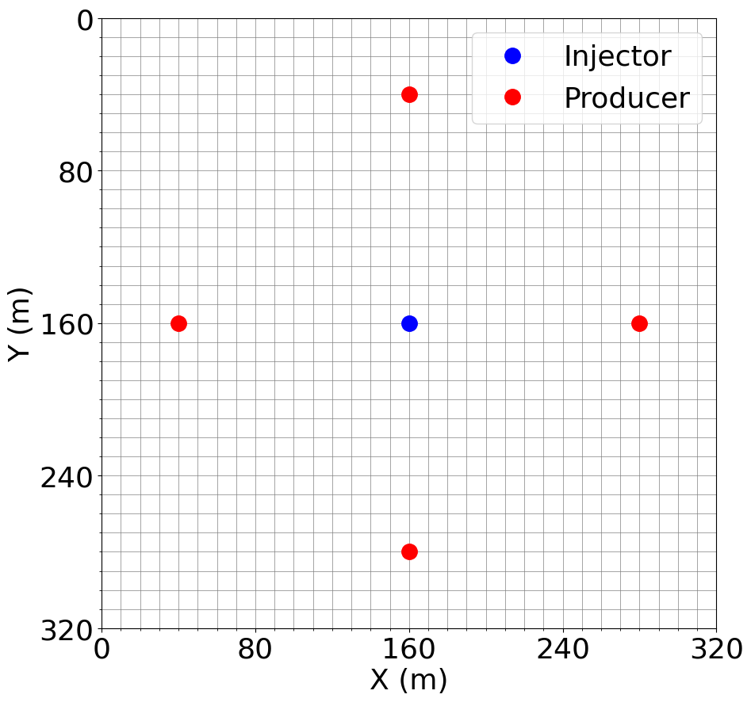
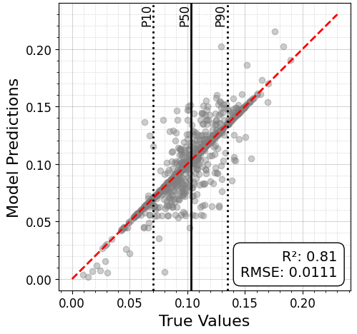
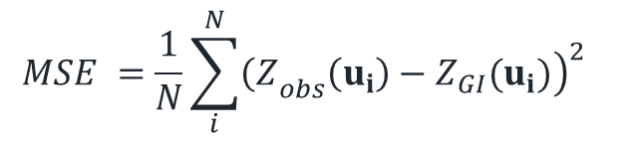
Methodology
Subsurface GenAI Model Minimum Acceptance Criteria Checks
Local Exactitude
Measure conditioning errors for conditioned models at data location, and conditioning reproduction for preconditioned models using mean square error.
$$MSE =\frac{1}{N}\sum_{i}^{N}{{\left.{\left(Z\right.}_{obs}\left(u_{i}\right)−Z_{GI}(u_{i})\right)}^{2} }$$
5
Figure 12. Truth plot for conditioning (Merzoug et al. 2024a, b)

Slide 16
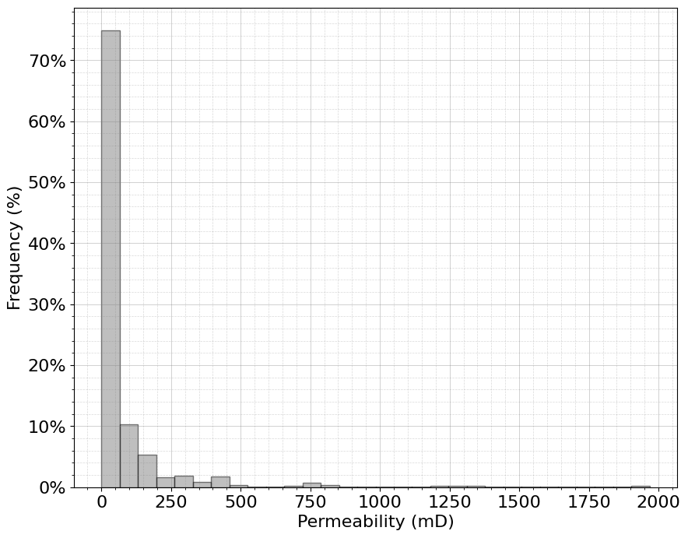
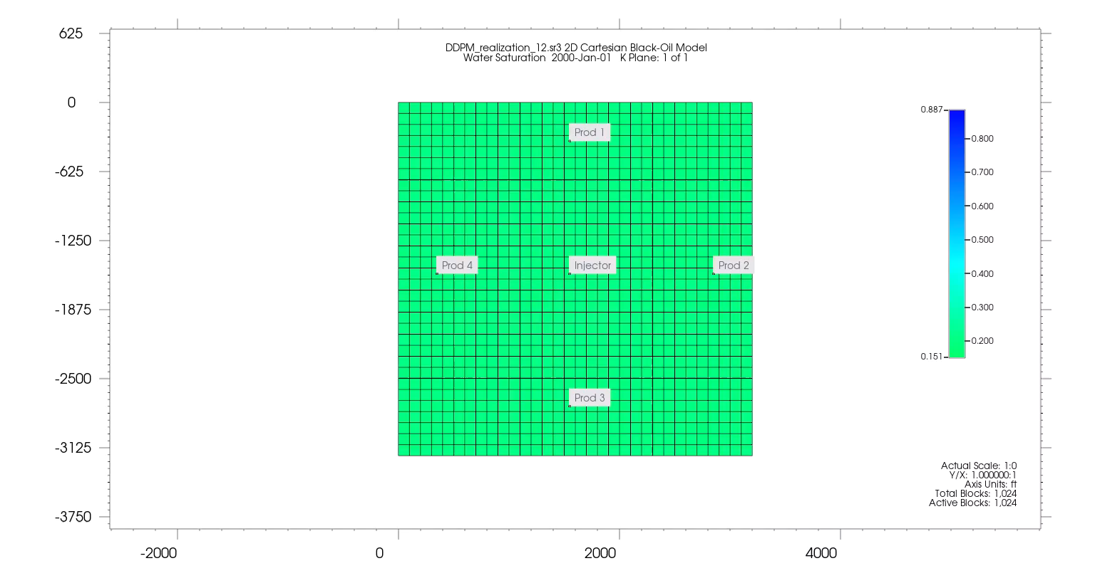
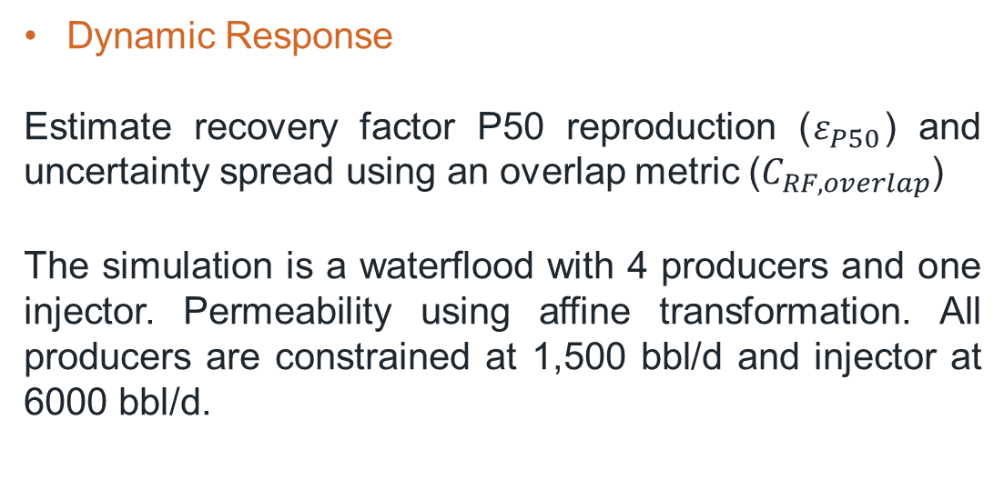
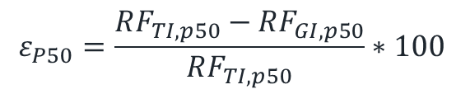
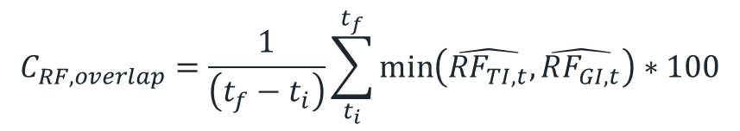
Figure 13. Permeability distribution
Methodology
Subsurface GenAI Model Minimum Acceptance Criteria Checks
Dynamic Response
Estimate recovery factor P50 reproduction ($ε_{P50}$) and uncertainty spread using an overlap metric ($C_{RF,overlap}$)
The simulation is a waterflood with 4 producers and one injector. Permeability using affine transformation. All producers are constrained at 1,500 bbl/d and injector at 6000 bbl/d.
$$C_{RF,overlap}=\frac{1}{\left(t_{f}−t_{i}\right)}\sum_{t_{i}}^{t_{f}}{\min\left(\hat{RF_{TI,t}},\hat{RF_{GI,t}}\right)}∗100$$
6
$$ε_{P50}=\frac{RF_{TI,p50}−RF_{GI,p50}}{RF_{TI,p50}}∗100$$
Figure 14. Fluid flow simulation

Slide 17
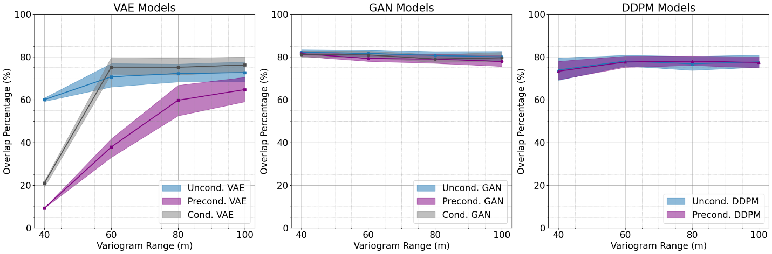
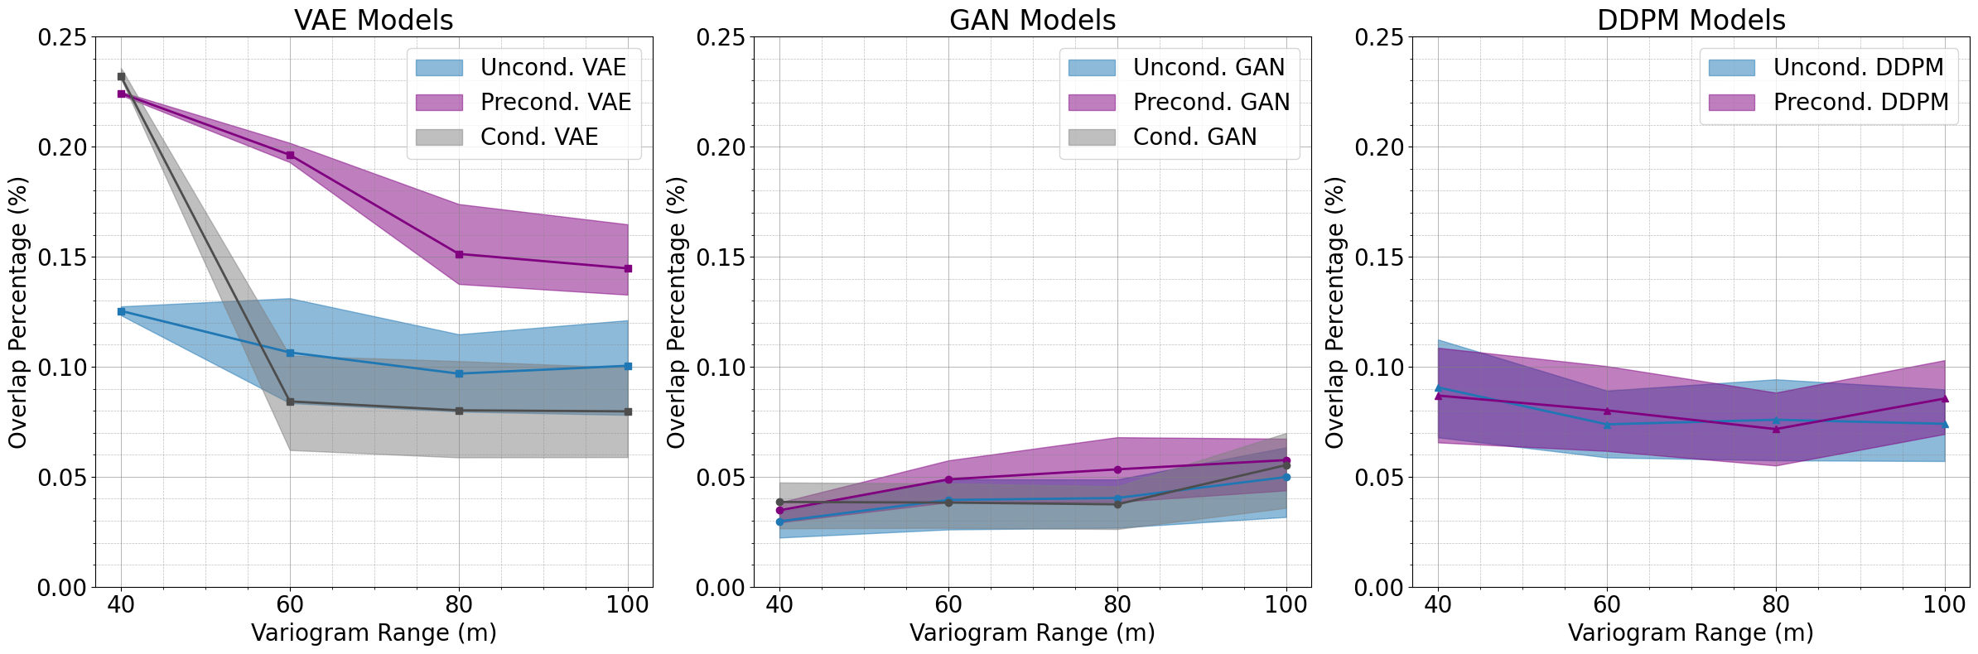
Results
Global Univariate Distribution
VAE models struggle to reproduce data distribution.
VAE performance is range-dependent. The performance improves with longer ranges.
GANs have the best reproduction of data distribution compared to other models, followed by DDPMs.
Figure 15. Distribution histogram overlap (Merzoug et al., 2024a)
Figure 16. Q-Q plot divergence area (Merzoug et al., 2024a)

Slide 18
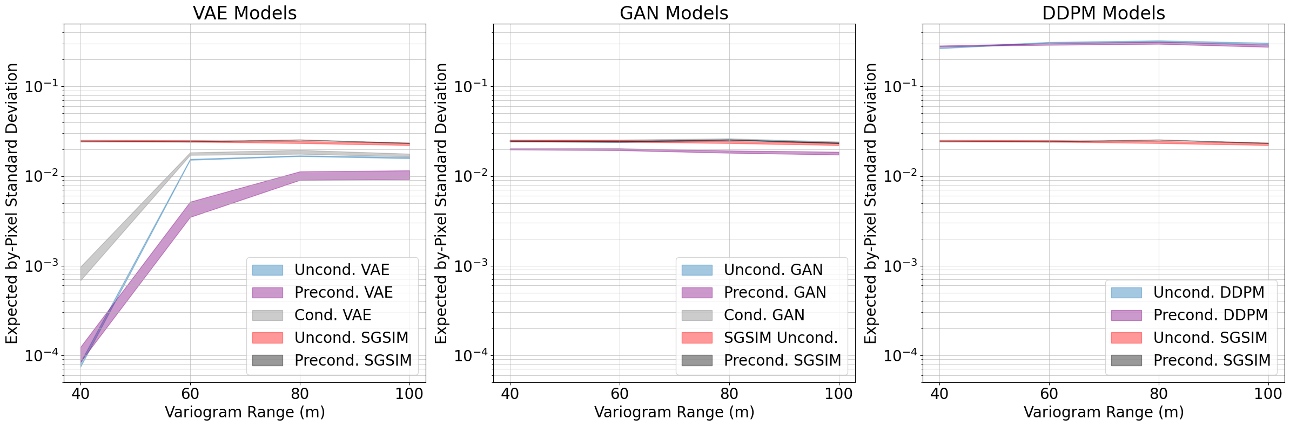
Results
Local Uncertainty
VAEs have very low local uncertainty reproduction. Their performance improve at longer ranges but suffer from mode collapse, especially Preconditioned VAEs.
GANs have the best reproduction of local uncertainty, whereas DDPMs have a larger local uncertainty range. These models are not affected by special continuity ranges.
2
Figure 17. By-cell expected standard deviation (Merzoug et al., 2024a)

Slide 19
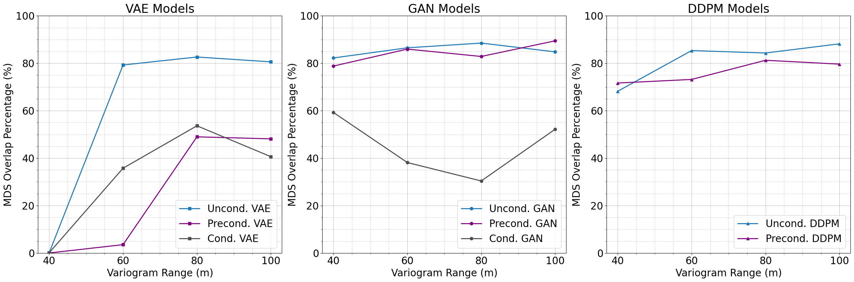
Results
Global Uncertainty
Unconditional VAEs have better global uncertainty reproduction than preconditioned and conditioned VAEs. The performance improves with longer ranges.
GANs (Uncond., Precond.) have the best reproduction compared to all other models. Conditioned GANs have low global uncertainty reproduction.
DDPMs have good uncertainty reproduction.
3
Figure 18. Overlap percentage in MDS space (Merzoug et al., 2024a)

Slide 20
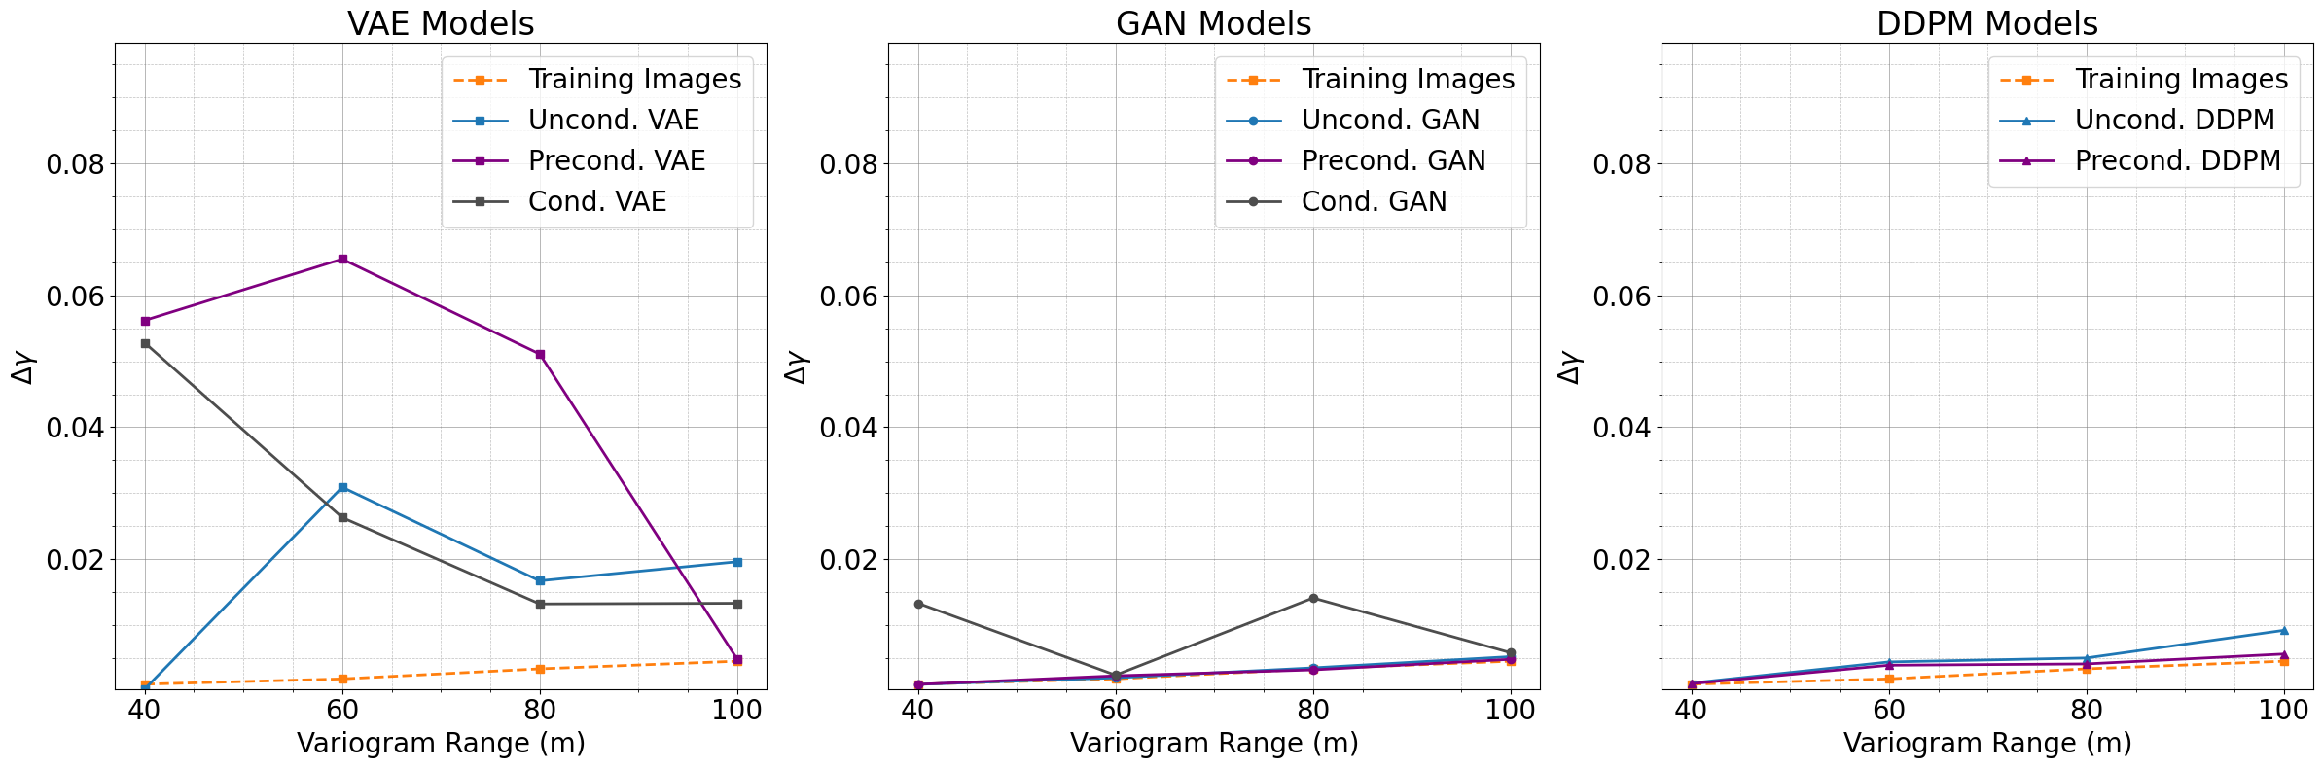
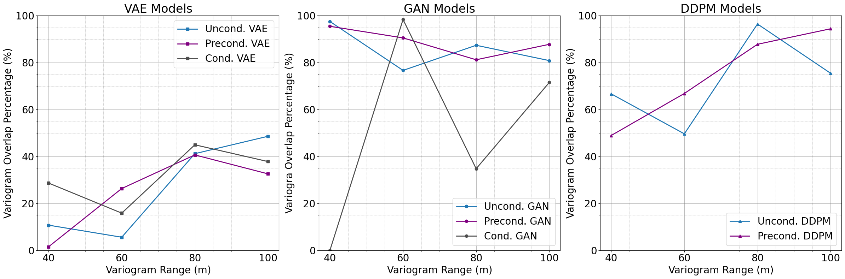
Results
Spatial Continuity Reproduction
VAEs have a very low level of spatial continuity and variety reproduction.
Uncond., precond. GANs followed by DDPM reproduce spatial continuity and variability very well.
Cond. GANs have good spatial reproduction and limited spatial variability reproduction.
Figure 19. Average Variogram difference (Merzoug et al., 2024a)
Figure 20. Variogram variety overlap (Merzoug et al., 2024a)

Slide 21
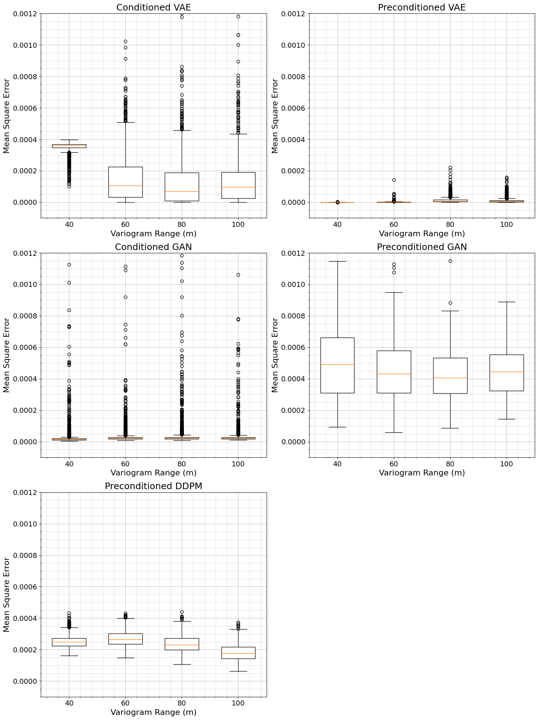
Results
Local Exactitude
Conditioned VAEs have better reproduction at longer ranges. Whereas preconditioned VAEs have the lowest errors.
Conditioned GANs have low errors, whereas preconditioned GANs have larger errors and struggle to learn data conditioning from training images.
Preconditioned DDPMs have relatively low errors.
5
Figure 21. Mean Square error for local exactitude (Merzoug et al., 2024a)

Slide 22
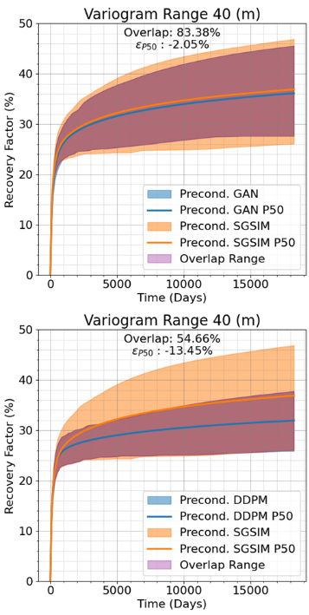
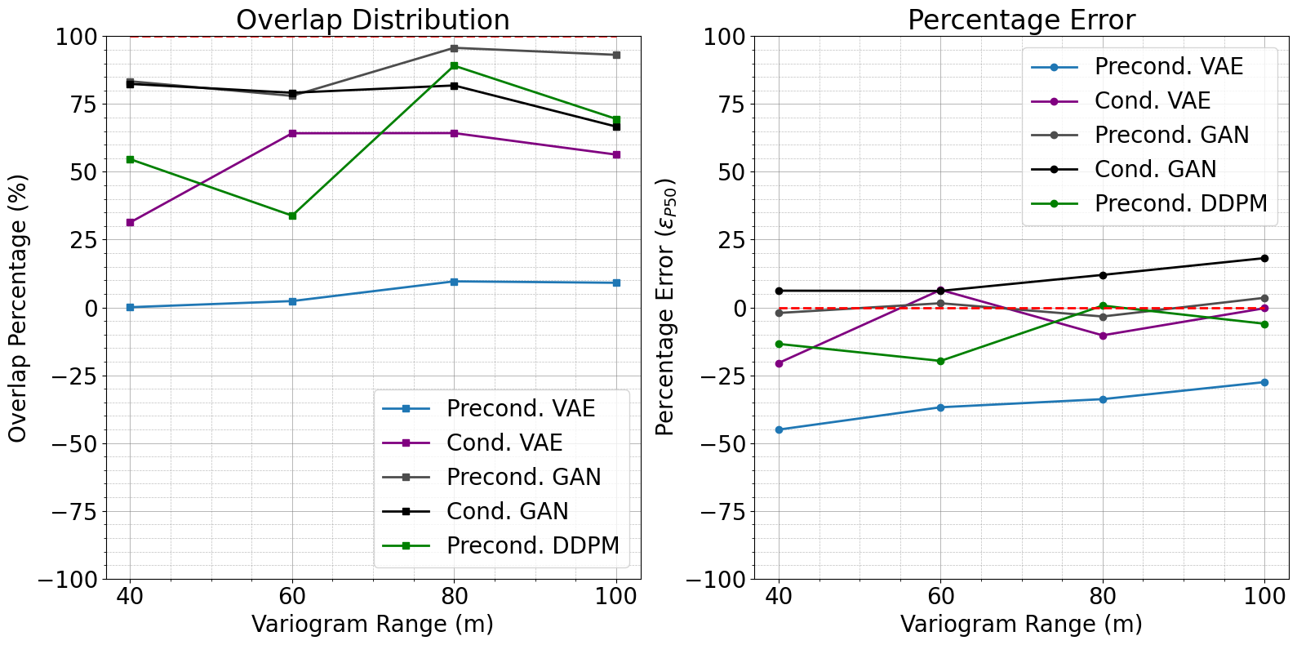
Results
Dynamic Response
For P50 reproduction models are ranked as Precond. GANs and DDPM followed by Cond. GANs and VAEs then Precond. VAEs as the worst model.
For uncertainty reproduction models are ranked as Precond. GANs, Cond. GANs and Precond. DDPMs followed by Cond. VAEs then Precond VAEs as the worst models in reproduction.
6
Figure 23. Recover factor accuracy and uncertainty
Figure 22. Recover factor response

Slide 23
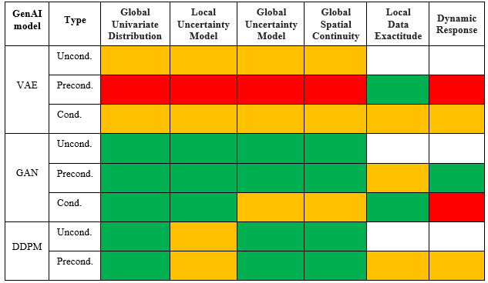
Conclusions
Reproduction
The proposed minimum acceptance criteria allow for a more quantitative check of genAI model.
We highlight the limitations of applying genAI models for subsurface modeling.
GANs outperform other models in most of the developed checks.
Using VAEs for subsurface modeling can result in poor subsurface decision-making process.
Low
High

Slide 24
Limitations
The developed subsurface genAI model minimum acceptance criteria protocol was only applied on continuous data.
The model was compared to SGSIM-based TIs and only basic architectures were used for the models. Other variants of genAI models can perform better against the proposed metrics, which limits the generalization of the comparison.
The conditioning process uses Constrained Optimization by Linear approximation; the use of other optimization algorithms can result in different results.

Slide 25

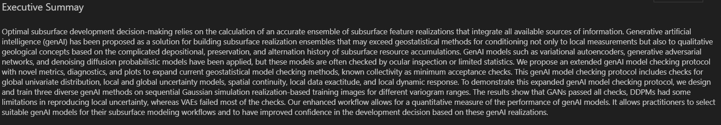
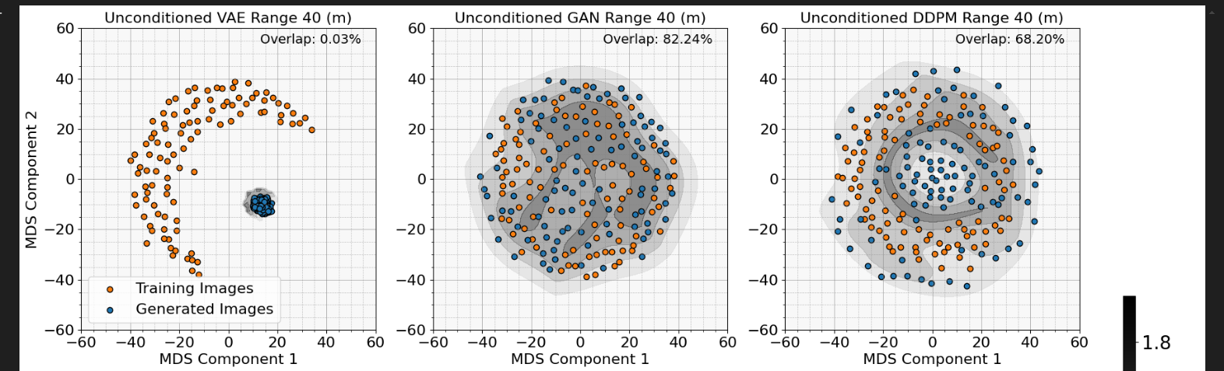
Try Out Our Proposed Workflow
GenAI Minimum Acceptance Checks Static and Dynamic Model Checking of Conditioning Generative Artificial Intelligence Models for Subsurface Modeling
https://utexas.app.box.com/folder/275066214793
Well pad 1

Slide 26













Acknowledgments
Appreciation for the support from the DIRECT member companies.
Well pad 1

Slide 27
Reference
Merzoug, A., & Pyrcz, M. J. (2024a). Conditional Generative Adversarial Networks for Subsurface Modeling: How Good They Really Are?. https://doi.org/10.21203/rs.3.rs-4219533/v1
Merzoug, A., Liu, L., Pyrcz, M. J. (2024b). GenAI Minimum Acceptance Checks Static and Dynamic Model Checking of Conditioning Generative Artificial Intelligence Models for Subsurface Modeling (in Press)

Slide 28
Thank You
Q & A
5th Direct Consortium annual meeting
August 30th, 2024
Your Name
Graduate Research Assistant, The University of Texas at Austin
Michael J. Pyrcz
Professor, The University of Texas at Austin
Co-authors
Affiliation

